Slide 1

See-food Service Supreme (SSS)
Castro, Rolf Sheehan
Gray, Haley
Juneja, Kunal
Suarez, Nathaniel

Slide 2

Introduction
See (Visual Perception) - “One of the five senses, it is one of the abilities to interpret the surrounding environment using light in the visible spectrum.”
Link:
https://en.wikipedia.org/wiki/Visual_perception
Food – “any substance consumed to provide nutritional support for the body.”
Link: https://en.wikipedia.org/wiki/Food
Supreme adjective - “superior to all others” synonyms: highest-ranking, head, top, superior, prime

Slide 3
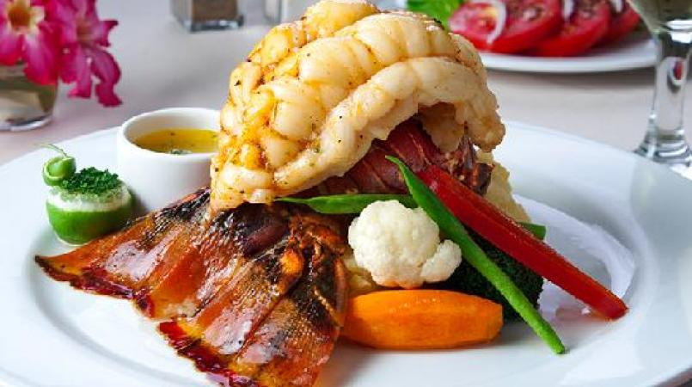
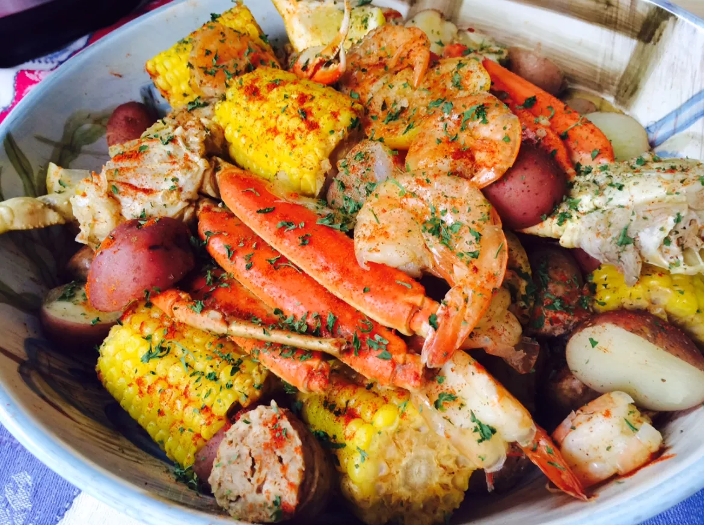
What is it for?
Fast and easy online shopping services for prime see-food
Fresh and high-quality see-food from different parts of the world
Online shopping for fresh produce

Slide 4
Our goal
To provide an online website for users to register for an account, place orders, track orders, and review order history
Provide a live-feed video of our livestock for users to pick and choose from
<2 Images here>

Slide 5
Our system’s features
3D body motion capture
Haptic system (touching)
Voice command
Safety shutdown
<2 images here>

Slide 6
DFD Level 0

Slide 7
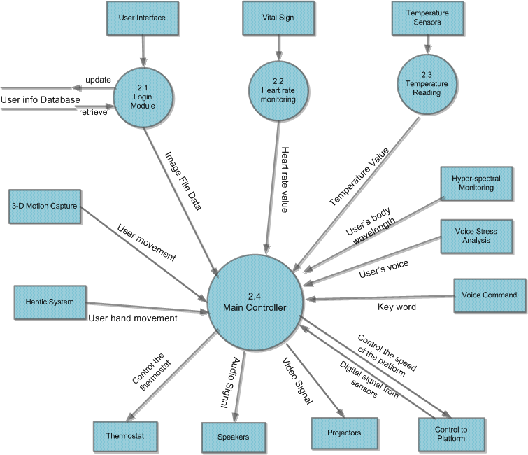
DFD Level 1

Slide 8
Test Matrix
Section Number | Requirement Description | Test Plan
2.1.1.1 | A login page shall display every time the software is launch. | Demonstration
2.1.1.2 | The login page shall have a field for the username | Demonstration
2.1.1.2.1 | The software shall compare username with existing username in the user info database | Demonstration
2.1.1.2.2 | The software shall return an error message if the username is not found in the user info database | Demonstration
2.1.1.3 | The login page shall have a field for the password. | Demonstration
2.1.1.3.1 | The software shall compare the password with the existing password in the user info database | Demonstration
2.1.1.3.2 | The software shall return an error message if the password is not found in the user info database. | Demonstration
2.1.1.4 | The login page shall have a link for the new user | Demonstration

Slide 9
Test Matrix
Section Number | Requirements Description | Test Plan
2.1.1.5 | The software shall launch a registration page when the user clicks on the new user link | Demonstration
2.1.1.5.1 | The registration page shall have a field for the user’s name | Demonstration
2.1.1.5.2 | The registration page shall have a field for the user’s address. | Demonstration
2.1.1.5.3 | The registration page shall have a field for the user’s phone number. | Demonstration
2.1.1.5.4 | The registration page shall have a field for the user’s email address. | Demonstration
2.1.1.5.5 | The registration page shall have a field for the user’s age | Demonstration

Slide 10
Test Matrix
Section Number | Requirements Description | Test Plan
2.1.1.5.6 | The registration page shall have a field for the username | Demonstration
2.1.1.5.6.1 | The username shall be at least 6 characters and containing only lowercase letters and numbers | Demonstration
2.1.1.5.6.2 | The software shall return an error message if the username is less than 6 characters | Demonstration
2.1.1.5.7 | The registration page shall have a field for the password. | Demonstration
2.1.1.5.7.1 | The password shall be at least 6 characters and containing a combination of numbers, lowercase letters, and uppercase letters | Demonstration

Slide 11
Test Matrix
Section Number | Requirements Description | Test Plan
2.1.1.5.7.2 | The password shall contain at least 1 uppercase letter, 1 lowercase letter, and 1 number | Demonstration
2.1.1.5.7.3 | The software shall return an error message if the password is less than 6 characters | Demonstration
2.1.1.5.7.4 | 4The software shall return an error message if the password doesn’t contain at least 1 uppercase letter, 1 lowercase letter, and 1 number | Demonstration
2.1.1.5.8 | The registration page shall have a submit button | Demonstration
2.1.1.5.9 | The user information shall be upload to the database server once the user click the submit button. | Demonstration
2.1.1.5.10 | The software shall return a successful message when the user information successfully uploads to the database server | Demonstration
2.1.1.6 | Another web page shall be display once the user login | Demonstration

Slide 12
Test Matrix
Section Number | Requirements Description | Test Plan
2.1.1.6.1 | There shall be a drop down box on this page | Demonstration
2.1.1.6.2 | The drop down box shall list all the available images in the hard drive. | Demonstration
2.1.1.6.3 | The software shall send the name of the selected image to the decoder. | Demonstration
2.1.1.7 | All images shall be store in the storage array | Demonstration
2.1.2.1 | The decoder shall select the image according to the user selection | Demonstration
2.1.2.2 | The decoding module shall uncompress the audio bit stream from the image file | Demonstration
2.1.2.3 | The decoding module shall uncompress the video bit stream from the image file | Demonstration
2.1.2.4 | The decoding module shall send uncompress audio file to the main controller | Demonstration
2.1.2.5 | The decoding module shall send uncompress video file to the main controller | Demonstration

Slide 13
Backup Slides
None.

